Slide 1
Learning Session 1
Overview of Continuous Quality
Improvement (CQI)

Slide 2
Learning Objectives
At the end of this module, participants should be able to:
Relate the historical perspective of Continuous Quality improvement (CQI).
Describe the importance of CQI in healthcare, especially within the TB/HIV diagnostic cascade.
Explain the need for tools to monitor laboratory processes.
Discuss common CQI tools.

Slide 3
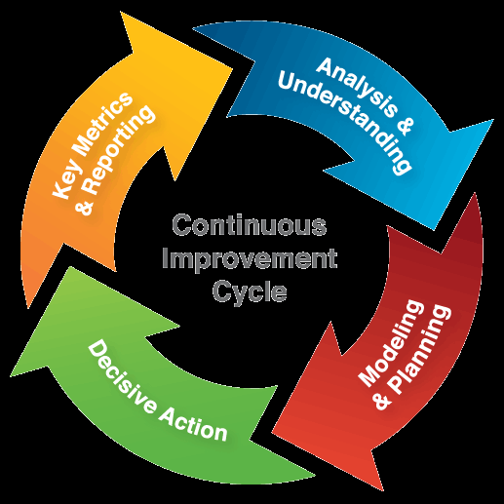
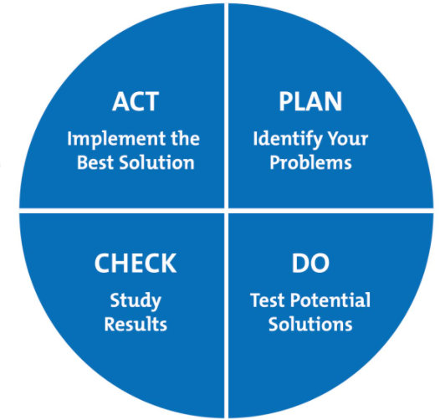
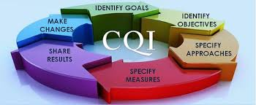
What is CQI?
PURPOSE:
To achieve higher levels
of performance

Slide 4
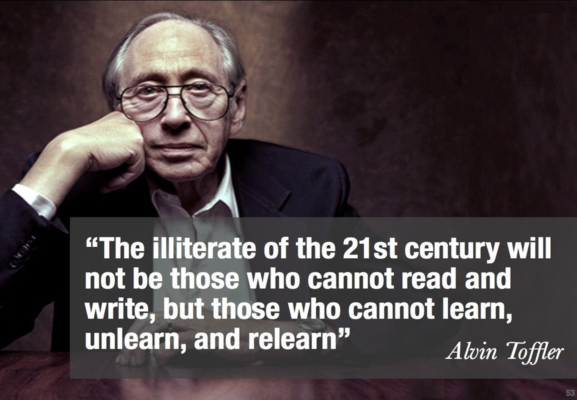
CQI is about Learning

Slide 5
Quality?
Customers’ desire, preference and level of satisfaction is the key to QUALITY!
The degree to which a set of inherent characteristics fulfils requirements.
-ISO 9000:2000

Slide 6

Quality Has No Destination
Has no end
Requires consistency
Its an attitude
Involves both personal and corporate commitment

Slide 7
What is CQI?
Continuous quality improvement (CQI) is a quality management philosophy that encourages all team members to continuously ask what can be done better. . .
Though CQI's focus on people, data drives the search for problems and captures improvements.
PURPOSE:
To achieve higher levels
of performance

Slide 8
ISO 15189 Defines CQI
Improves effectiveness of QMS
Compares performance with set targets
Effectiveness of actions to be measured through objective review / assessment
Should measure and improve outcomes of patient care
Improvements plans should be communicated

Slide 9
Continual Improvement
Develop a
Plan for
improvement
Identify
potential
sources
of error
Implement
Adjust the
action plan
and modify
Review the
effectiveness
of action
(ISO 15189:2012 clause 4.12)

Slide 10

CQI Principle
“Most Problems are Found in Processes and Systems, Not in People”

Slide 11
How Processes Fail
Poor design
Too complex
Not well understood by those who work in them
Not set up to deliver what the “individuals and populations” require

Slide 12

Failed Processes Affect Employees as Well
They get frustrated
Their workload increases (more “non-real work”)
They can be unfairly blamed
They don’t get the satisfaction of doing a good job

Slide 13

Why We Focus on Processes
“Each process is perfectly designed to get the results it achieves”
Getting a better result therefore requires re-designing the process

Slide 14

The DMAIC Tool
CQI Framework used by Laboratory African Regional Collaborative (LARC)

Slide 15


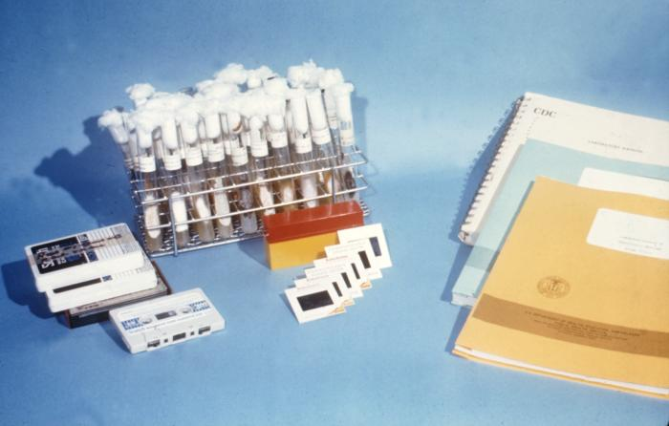
Quality Improvement Activities
Correct or prevent poor practices
Report progress to management and laboratory staff

Slide 16


Quality Improvement Activities
Use available information to study:
customer’s suggestions or complaints
identified errors from occurrence management program
problems identified in internal audits
?

Slide 17
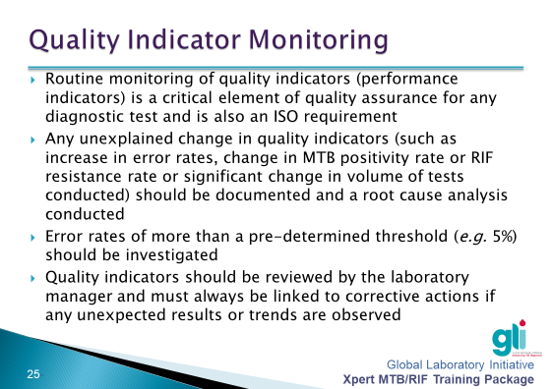
Training Modules for
Xpert MTB/RIF Ultra
stoptb.org/gli/trainingpackage

Slide 18
Essentials for Implementation
  Commitment
  Planning
  Structure
  Leadership Participation and Engagement
Continual
Improvement

Slide 19
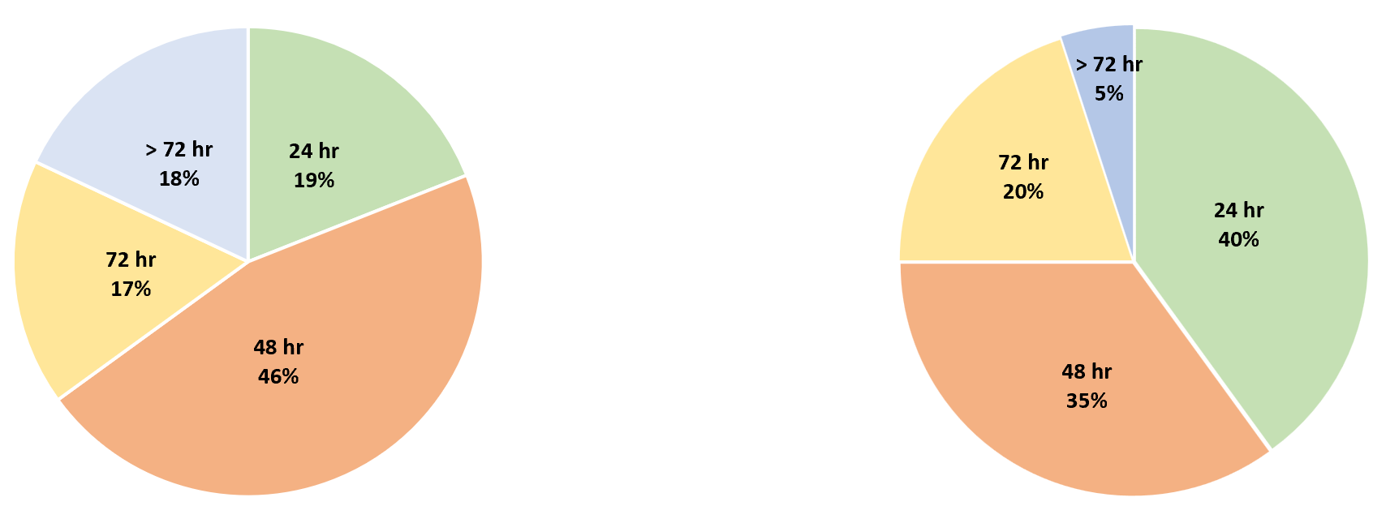
Quality Improvement Activities
Design a study so that results can be statistically measured.
Pre lean state for timely reporting of MTB detected/ RIF resistance detected mWRD test results
Post lean state for timely reporting of MTB detected/ RIF resistance detected mWRD test results

Slide 20
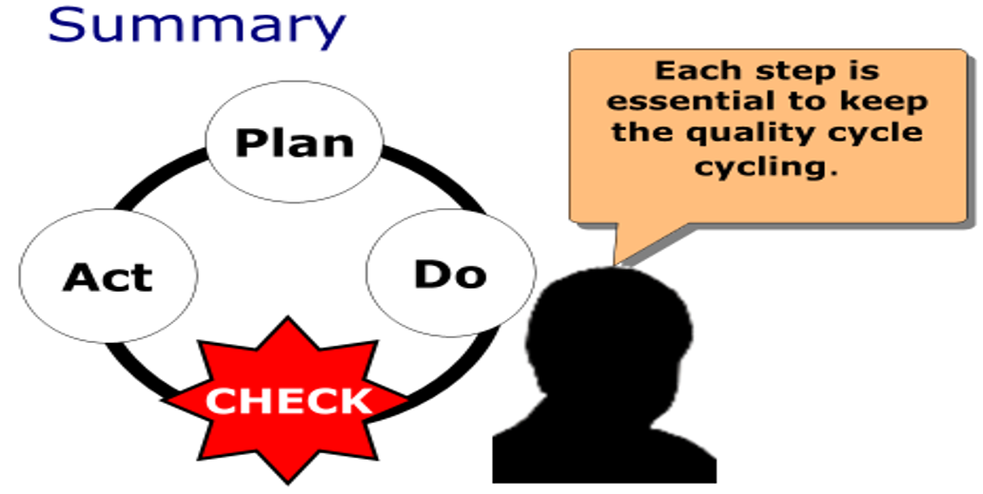
Summary

Slide 21
References
WHO Laboratory Quality Management System: Handbook
SLMTA Program
Global Laboratory Initiative –Training Modules for Xpert MTB/RIF Ultra
https://www.who.int/ihr/publications/lqms_en.pdf
https://slmta.org/
stoptb.org/gli/trainingpackage

Slide 22
Questions?

